Slide 1
Scrum & ETFS
Lunch and Learn – Oct 21, 2014
Mike O’Brien

Slide 2
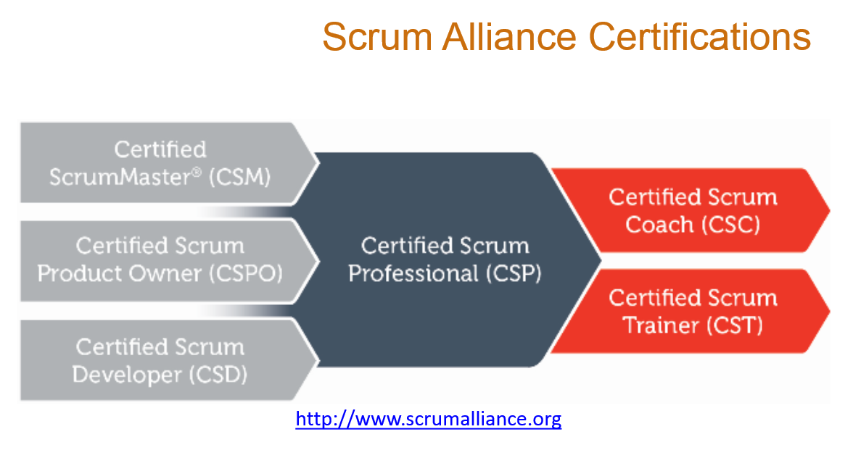
ScrumMaster Training
Attended ScrumMaster training in early August from cPrime
Overview of the training, i.e., 2 days in 1 hour

Slide 3
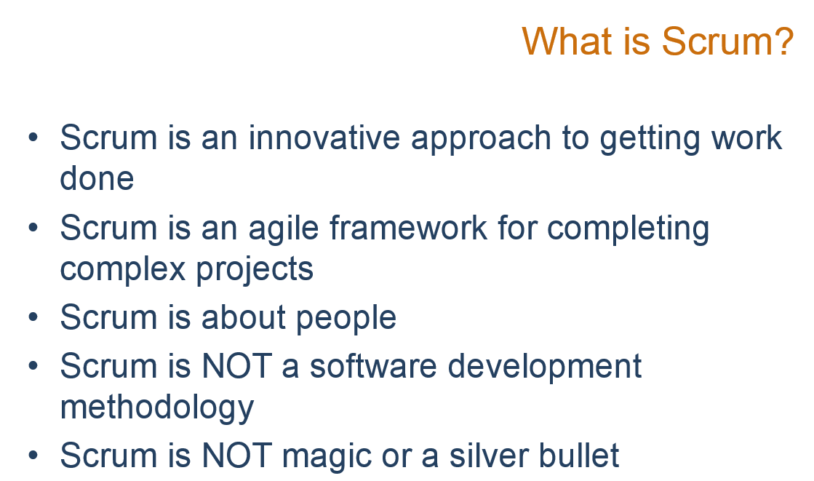

Slide 4
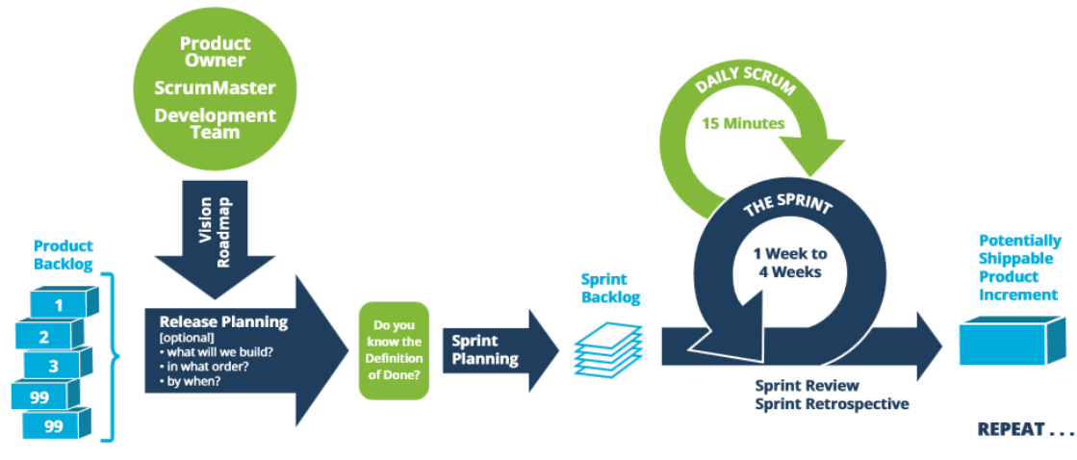
Scrum

Slide 5
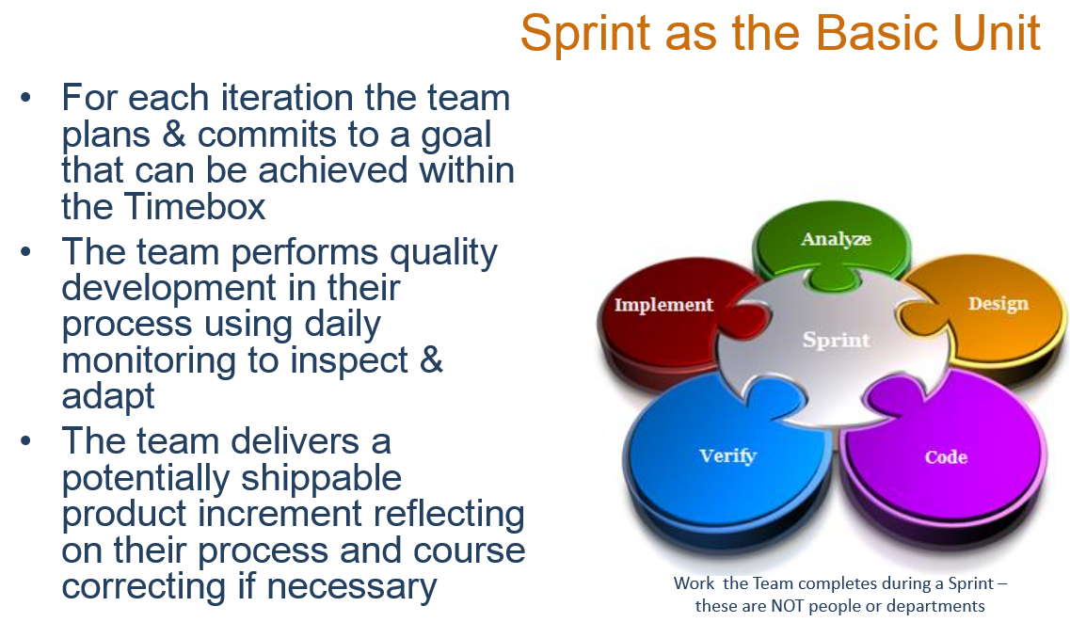

Slide 6
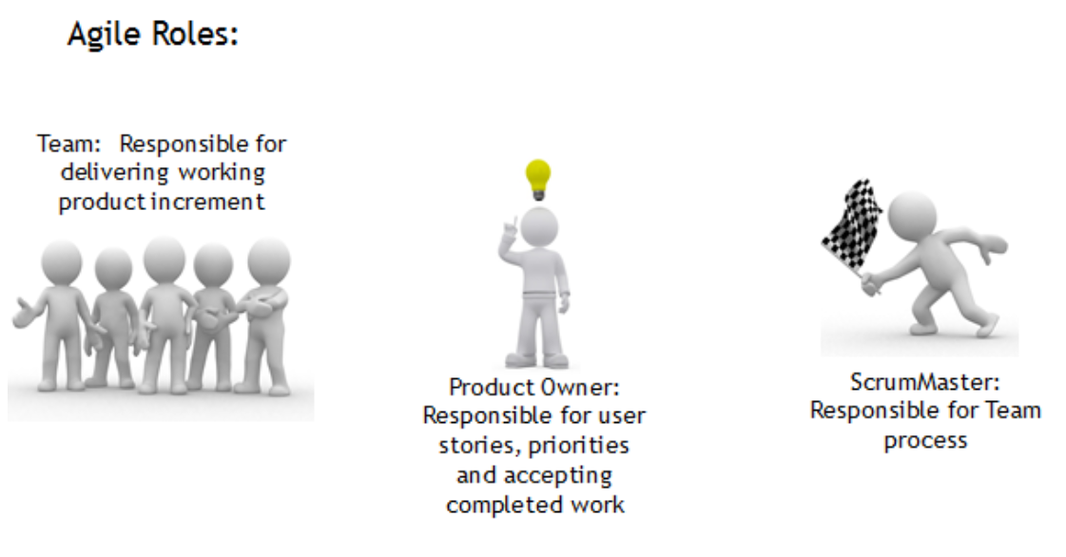
Scrum Roles

Slide 7
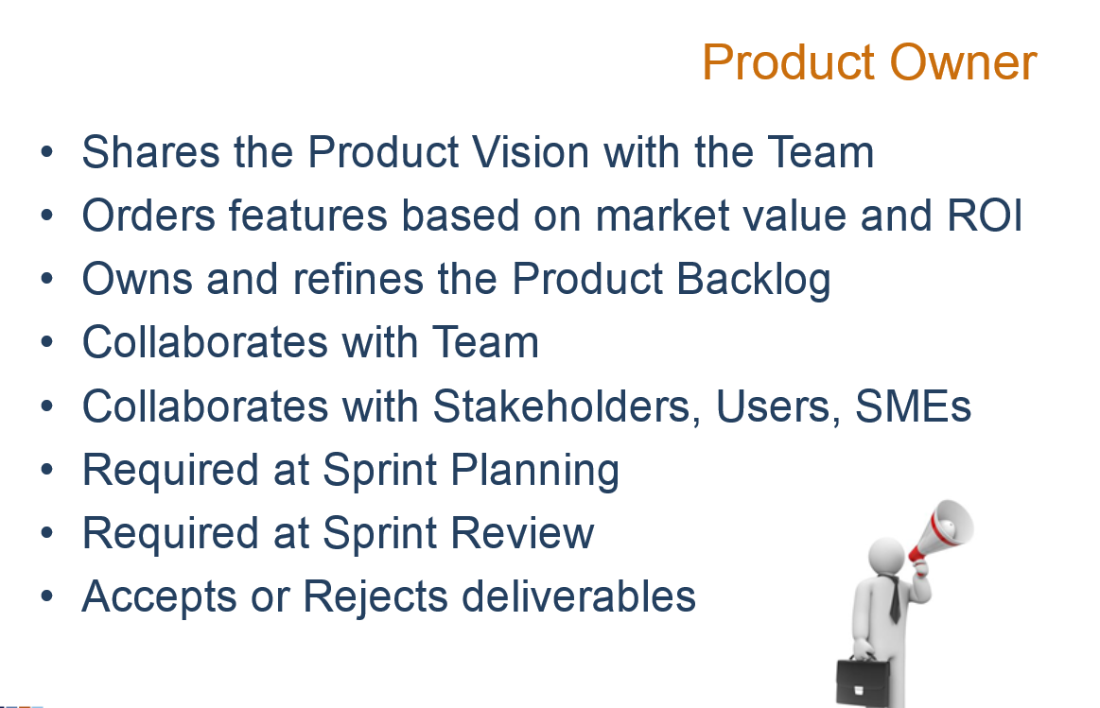

Slide 8
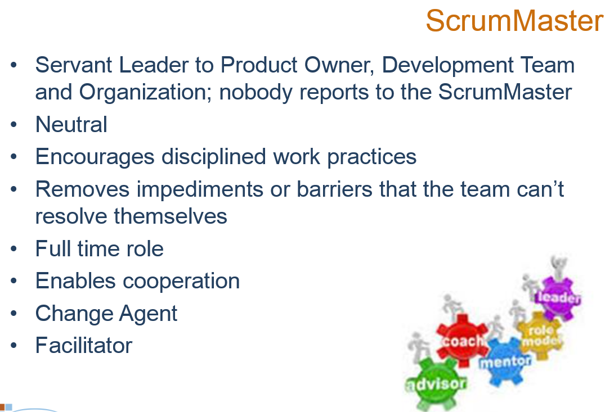

Slide 9
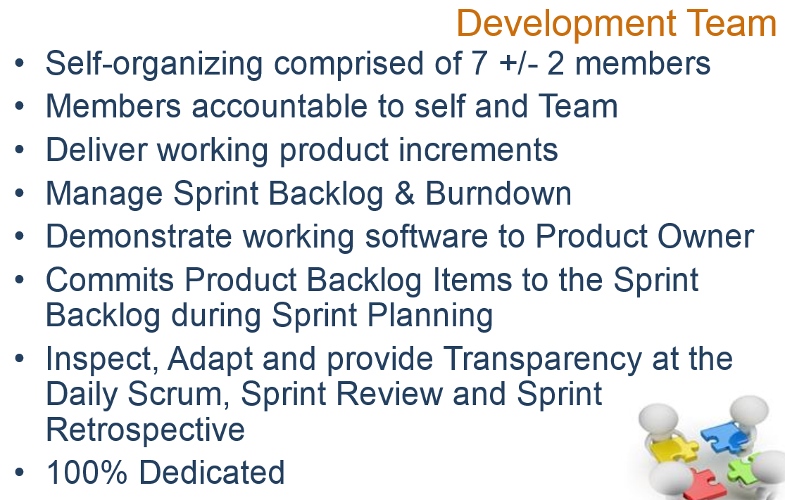

Slide 10
Scrum Artifacts
Product Backlog: ordered list of desired features, outcomes, issues, etc, owned by the Product Owner
Working Product Increments: slice of functionality that provides value delivered at the end of each Sprint
Sprint Backlog: committed Product Backlog Items broken down into Tasks and owned by the Team

Slide 11
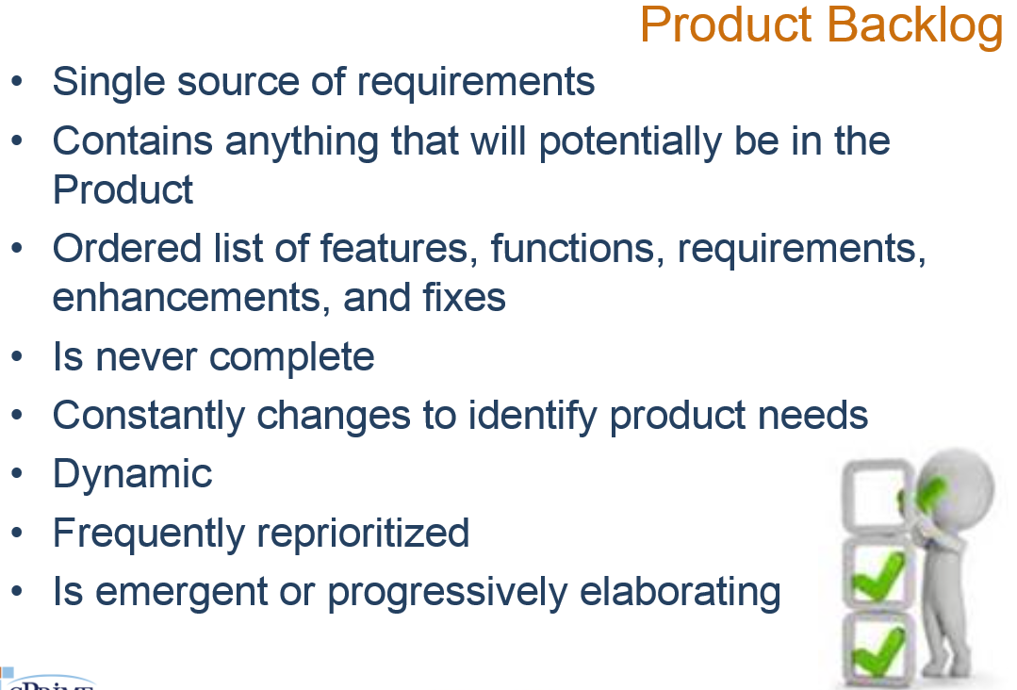

Slide 12
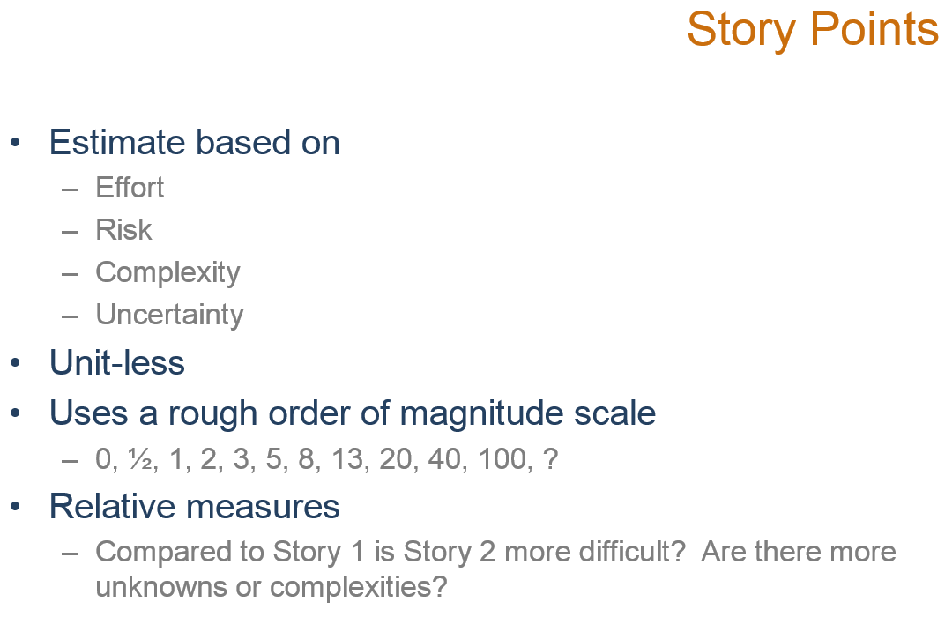

Slide 13
Scrum Ceremonies (Meetings)
Sprint Planning: held at the beginning of each sprint for the team to commit Product Backlog Items to the Sprint Backlog
Sprint Standup (Daily Scrum): a 15 minute time-boxed event for the Team to inspect, adapt and transparently synchronize on the Sprint Goal
Sprint Review: Feedback mechanism for stakeholders to see working product increments
Sprint Retrospective: an inspect and adapt mechanism for the Team regarding their Process

Slide 14
Scrum Ceremonies (Meetings)
Release Planning (Optional): An optional session that comes from the eXtreme Programming framework
A Release is made up of multiple Sprints or Iterations
In this session the Product Owner, ScrumMaster, and Team and anyone else necessary collaborate on:
What to Build
In What Order
By When

Slide 15
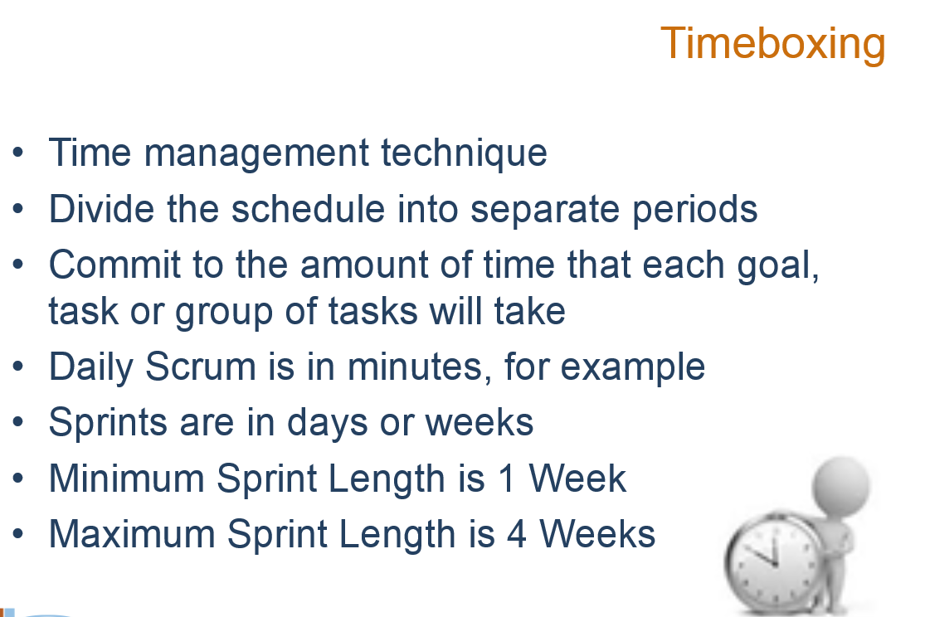

Slide 16
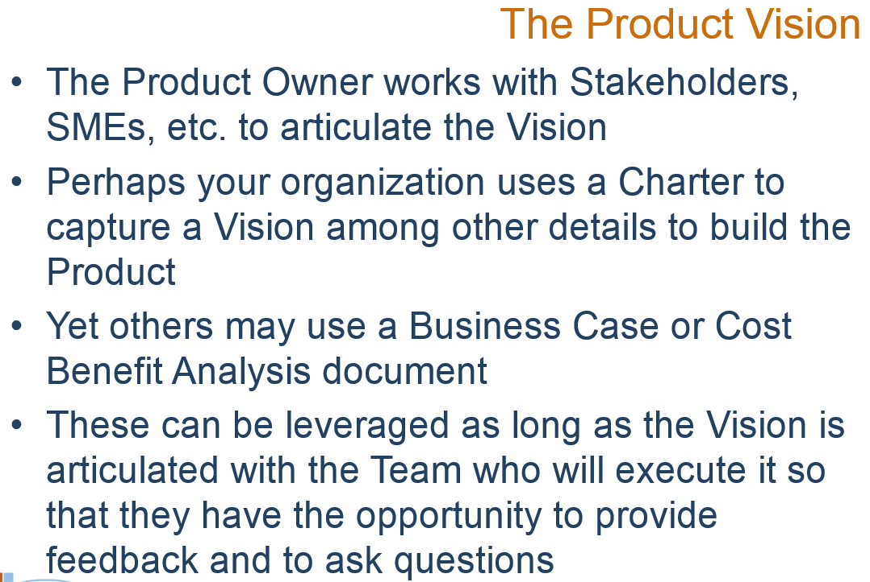

Slide 17
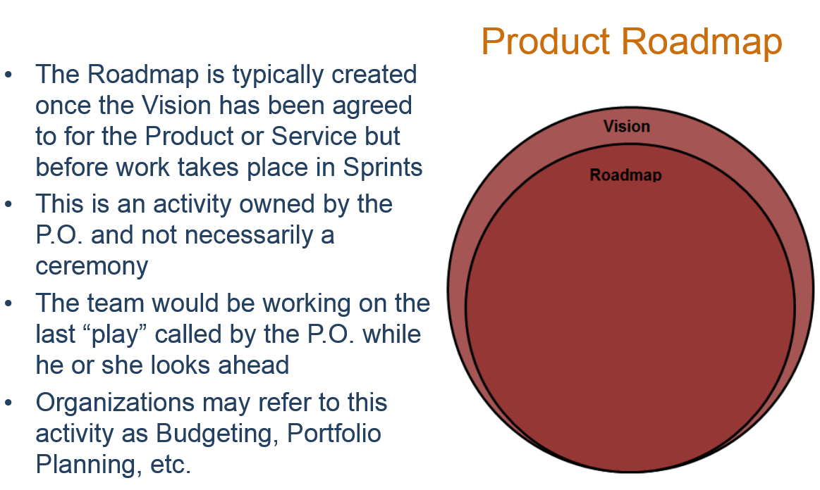

Slide 18
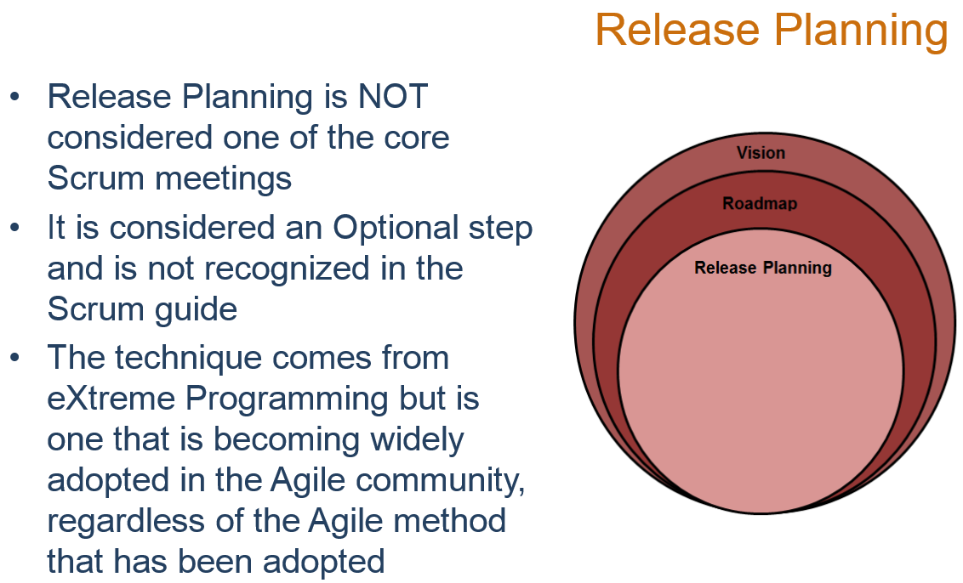

Slide 19
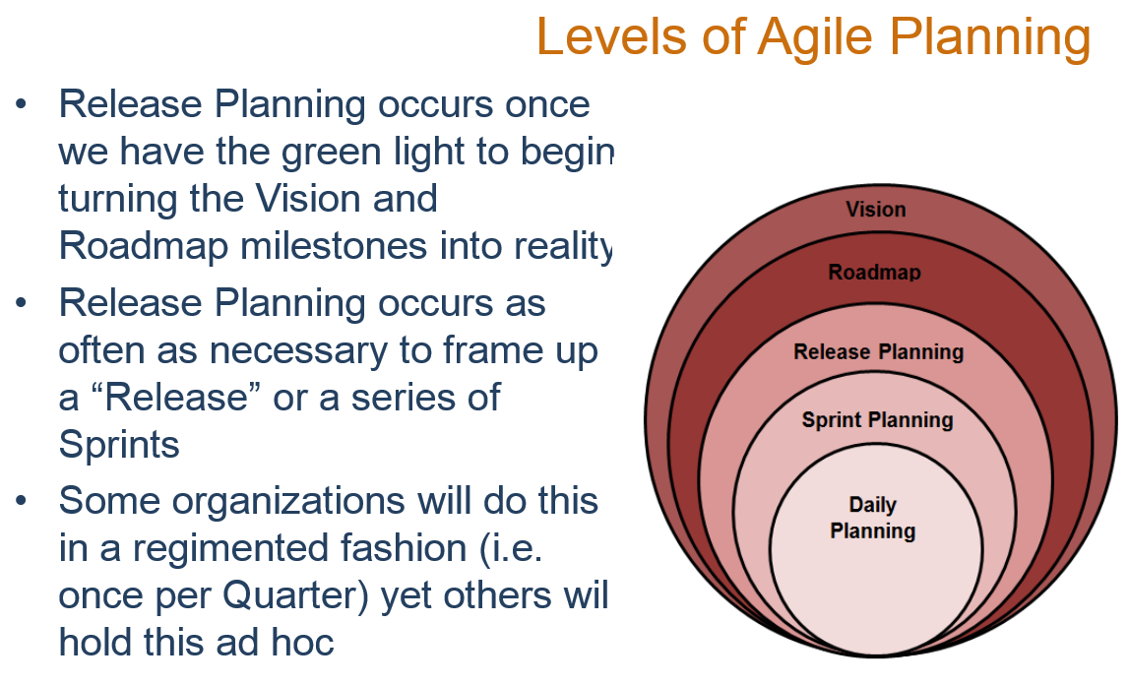

Slide 20
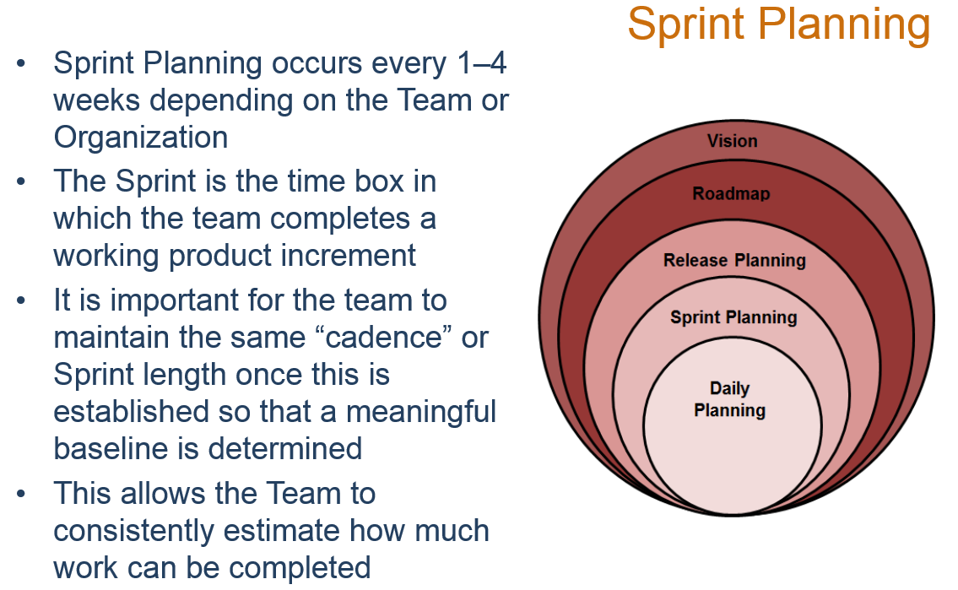

Slide 21
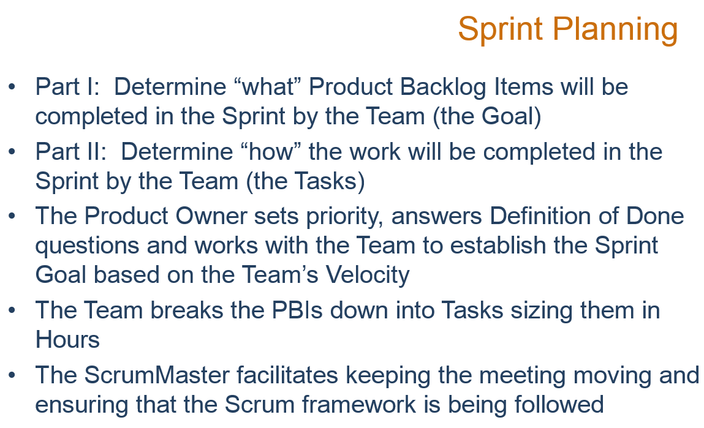

Slide 22
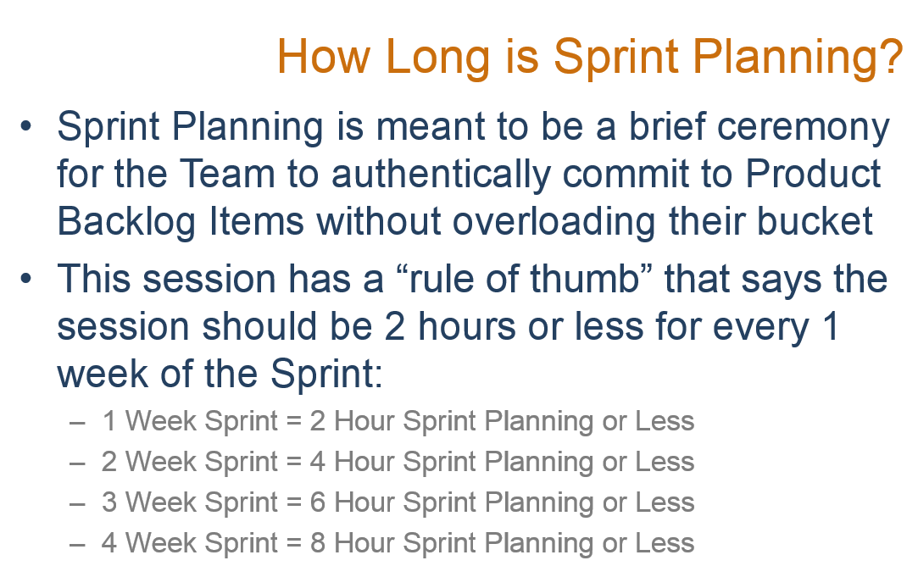

Slide 23
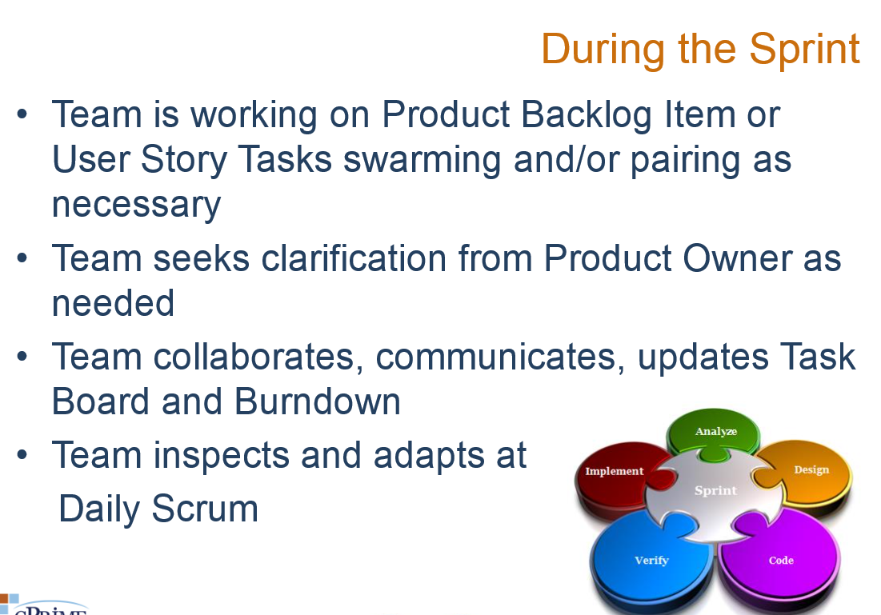

Slide 24
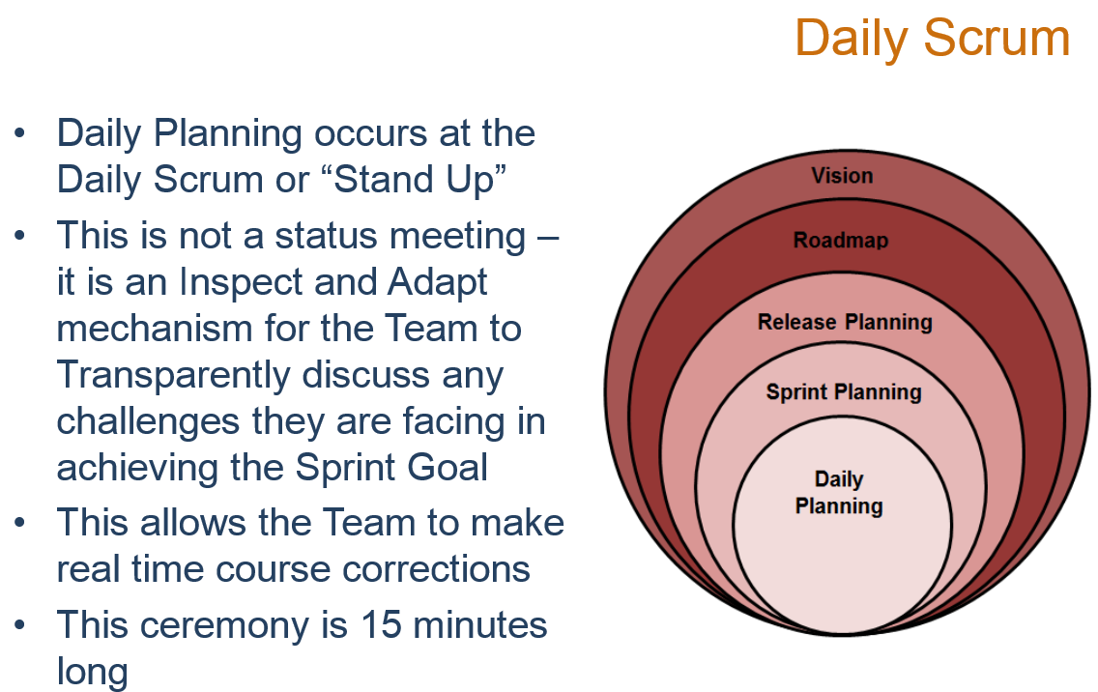

Slide 25
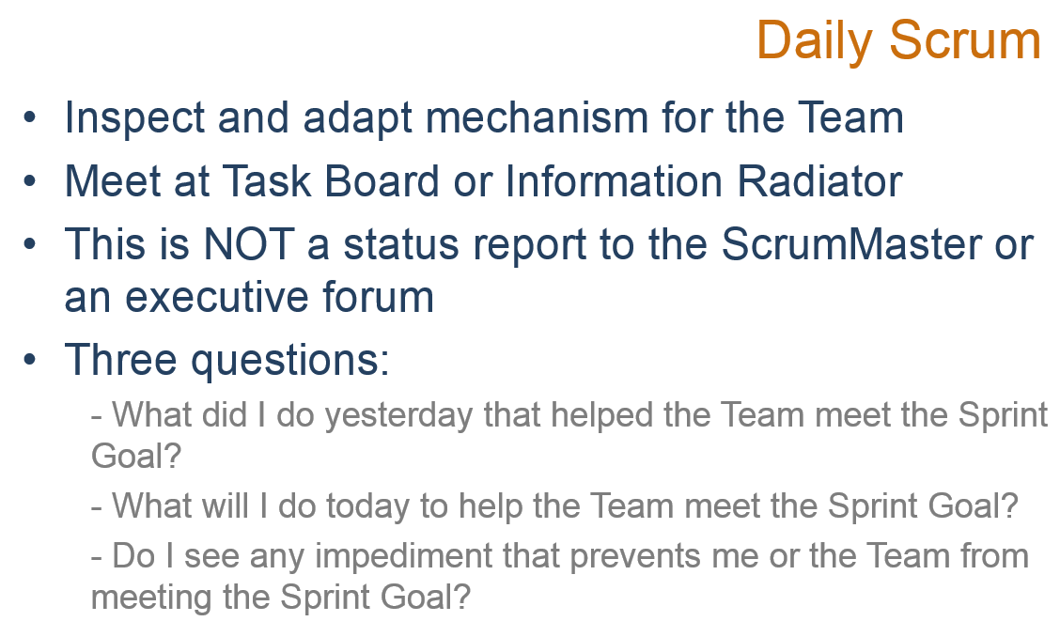

Slide 26
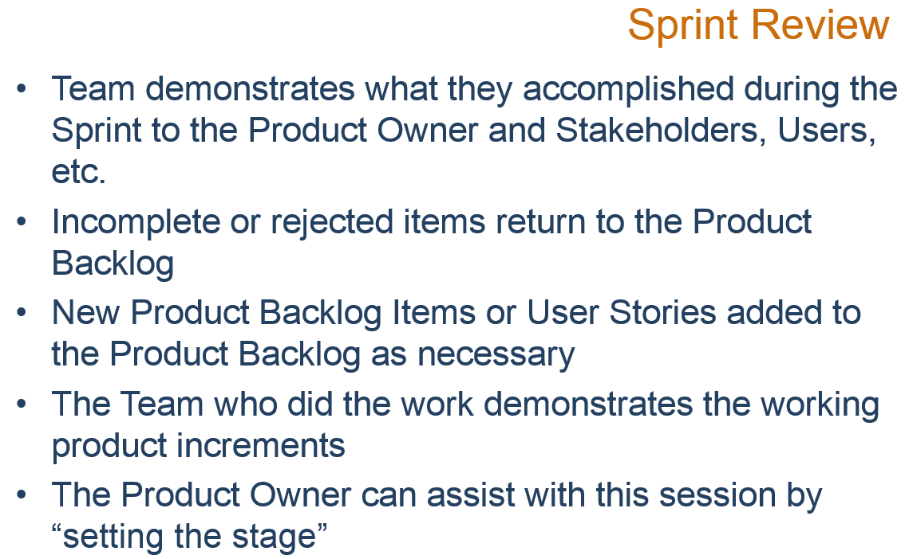

Slide 27
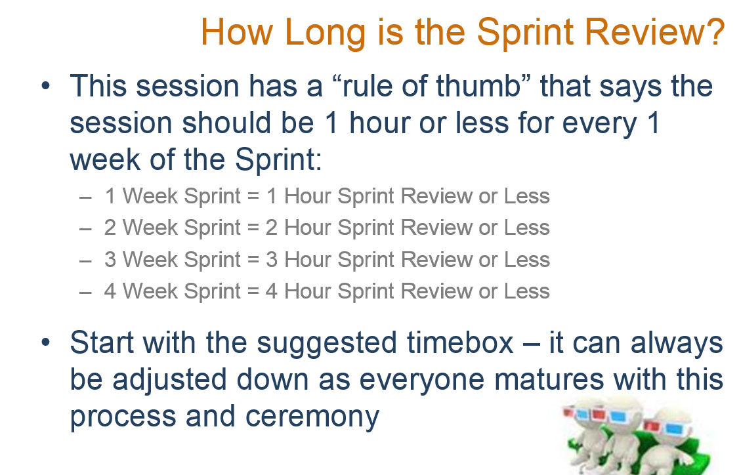

Slide 28
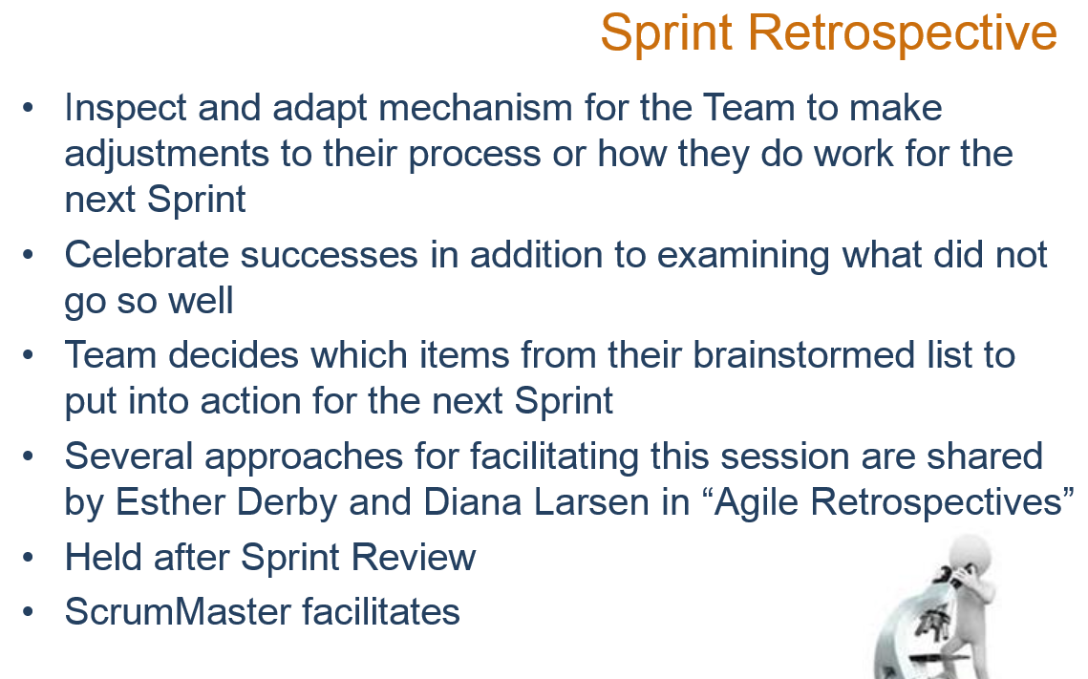

Slide 29
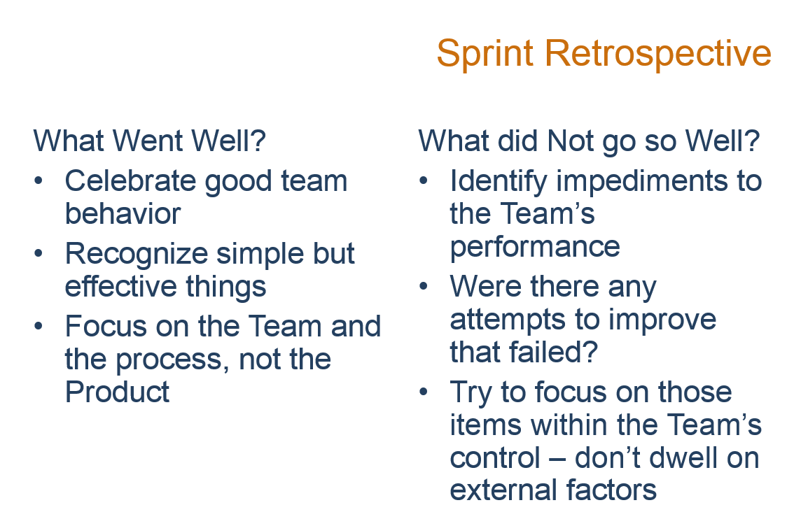

Slide 30
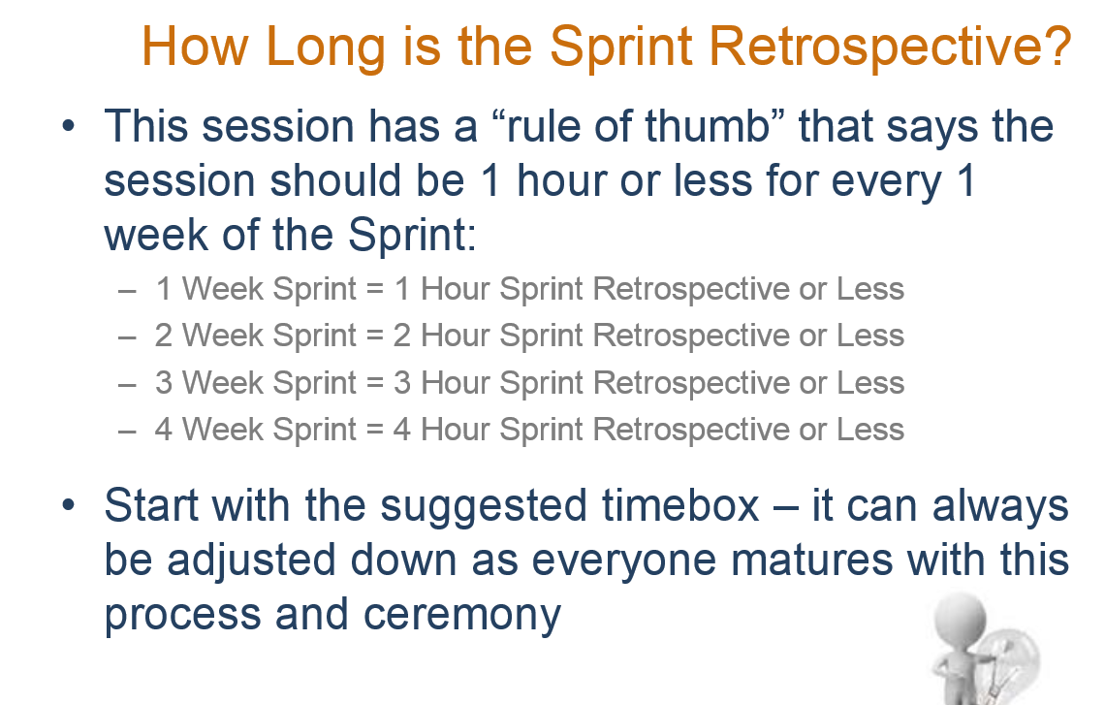

Slide 31
ETFS Demo
http://tfs.mmm.com:8080/tfs/DefaultCollection/etfs

Slide 32
